Slide 1



Software Development and Professional Practices
Software Testing Design Patterns

Slide 2
Objectives
Understand what is software testing
Understand the purpose of testing
Introducing development testing
Exploring JUnit tool
------------------------------------------------------------------ ------------------------------------------------------------------
Introducing the concept of design patterns
Observer design pattern example

Slide 3
Content
Introduction
Development Testing
JUnit Example
Design Pattern Introduction
Observer Example

Slide 4

Introduction
Software Testing is a method to check whether the actual software product matches expected requirements and to ensure that software product is defect-free.
The purpose of software testing is to identify errors, gaps or missing requirements in contrast to actual requirements.

Slide 5
Introduction
Testing is important because software bugs could be expensive or even dangerous:
Nissan cars recalled over 1 million cars from the market due to software failure in the airbag sensory detectors. There has been reported two accident due to this software failure.
Starbucks was forced to close about 60 percent of stores in the U.S and Canada due to software failure in its POS system. At one point, the store served coffee for free as they were unable to process the transaction.
Some of Amazon's third-party retailers saw their product price is reduced to 1p due to a software glitch. They were left with heavy losses.
Vulnerability in Windows 10. This bug enables users to escape from security sandboxes through a flaw in the win32k system.

Slide 6
Introduction
When you test software, you are trying to do two things:
Validation Testing
Defect Testing
Demonstrate to the developer and the customer that the software meets its requirements.
Find inputs where the behaviour of the software is incorrect, undesirable, or does not conform to its specification.
The user needs a scientific calculator program. Have I developed a scientific calculator.
Does the calculator compute the distance between two points CORRECLTY?

Slide 7
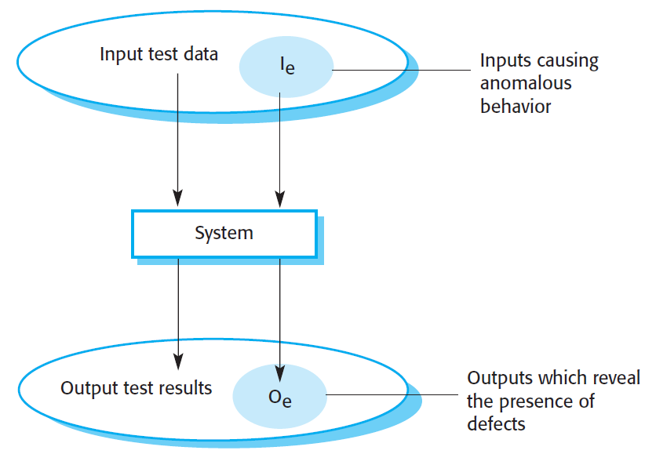

Introduction
The differences between validation testing and defect testing
The system accepts inputs from some input set $I$ and generates outputs in an output set O.
The priority in defect testing is to find those inputs in the set $I_{e}$ because these reveal problems with the system.
Validation testing involves testing with correct inputs that are outside $I_{e}$.

Slide 8
Introduction
A software system must go through three stages of testing:
Stages of testing
Development testing
Release testing
User testing

Slide 9
Content
Introduction
Development Testing
JUnit Example
Design Pattern Introduction
Observer Example

Slide 10
Development Testing
Development testing includes all testing activities that are carried out by the team developing the system.
Debugging is the process of fixing errors and problems that have been discovered by testing.
Using information from the program tests, debuggers use their knowledge of the programming language and the intended outcome of the test to locate and repair the program error.

Slide 11
Development Testing
There are three stages of development testing:
Stages of development testing
Unit testing
Component testing
System testing

Slide 12
Development Testing
Unit testing
Individual program units or object classes are tested.
Unit testing should focus on testing the functionality of objects or methods.
Component testing
Several individual units are integrated to create composite components.
Component testing should focus on testing the component interfaces that provide access to the component functions.
System testing
The components in a system are integrated and the system is tested.
System testing should focus on testing component interactions.

Slide 13
Development Testing
U1
U1
U3
U2
U3
U2
U4
U4
U1
U1
U3
U2
U3
U2
U4
U4

Slide 14
Development Testing
Unit Testing
U1
U1
U3
U2
U3
U2
U4
U4
U1
U1
U3
U2
U3
U2
U4
U4

Slide 15
Development Testing
Component Testing
U1
U1
U3
U2
U3
U2
U4
U4
U1
U1
U3
U2
U3
U2
U4
U4

Slide 16
Development Testing
System Testing
U1
U1
U3
U2
U3
U2
U4
U4
U1
U1
U3
U2
U3
U2
U4
U4

Slide 17
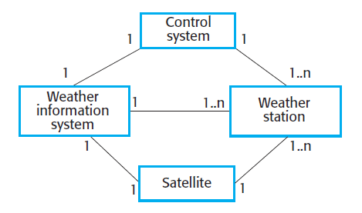
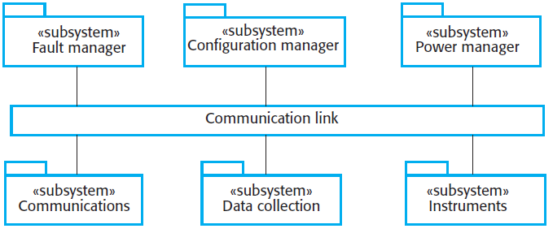
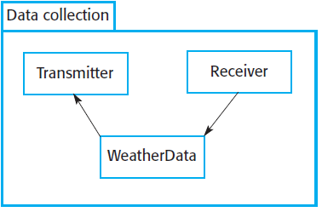
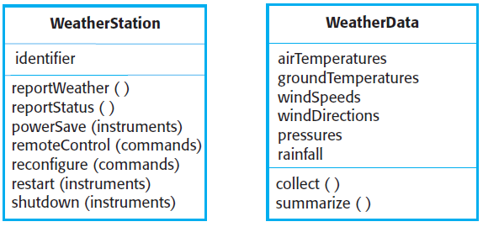
Example: Weather System
System context for the weather station
High-level architecture of weather station
Architecture of data collection system
Weather station objects

Slide 18
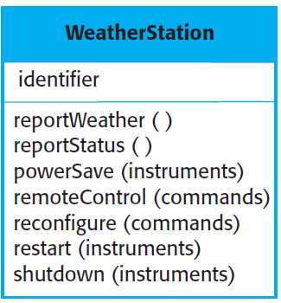

Development Testing – Unit Testing
Unit testing is the process of testing program components, such as methods or object classes.
You define test cases for all of the methods associated with the object such as $reportWeather$ and $reportStatus$.
You should test methods in isolation.
In some cases, test sequences are necessary.
For example, to test the method that shuts down the weather station instruments ($shutdown$), you need to have executed the $restart$ method.

Slide 19
Development Testing – Component Testing
Software components are often made up of several interacting objects.
For example, in the weather station system, the reconfiguration component includes objects that deal with each aspect of the reconfiguration.
You access the functionality of these objects through component interfaces.

Slide 20
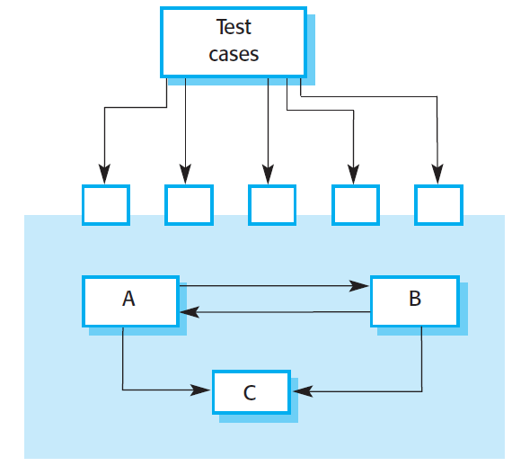
Development Testing – Component Testing
Testing composite components focus on showing that the component interface or interfaces behave according to its specification.
Assume that components A, B, and C are integrated to create a larger component or subsystem.
The test cases are not applied to the individual components but rather to the interface of the composite component created by combining these components.

Slide 21
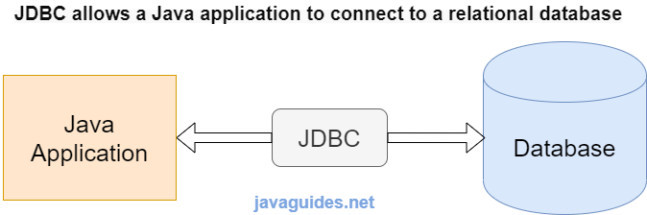
Development Testing – Component Testing
Testing composite components focus on showing that the component interface or interfaces behave according to its specification.
Another example, testing JDBC that connects the java application to the database.
Assume that your Java app is working properly.
Assume that your DBMS working properly.

Slide 22
Development Testing – System Testing
System testing during development involves integrating components to create a version of the system and then testing the integrated system.
System testing checks that:
components are compatible,
interact correctly,
and transfer the right data at the right time across their interfaces.

Slide 23
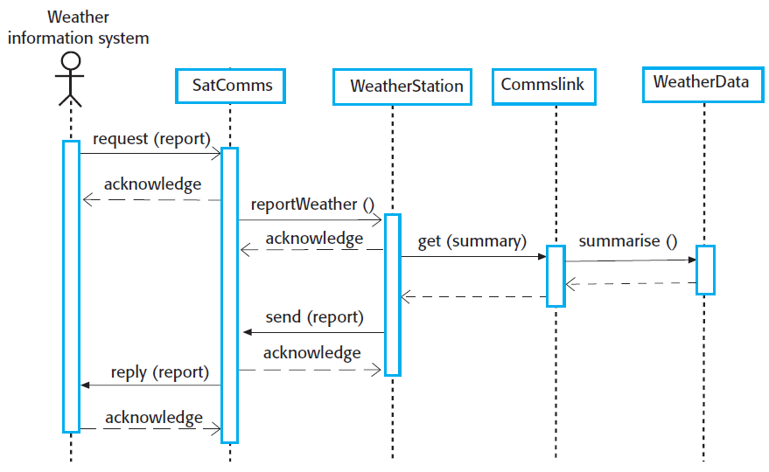
Development Testing – System Testing
In the wilderness weather station example, the system software reports summarized weather data to a remote computer.
You can use this diagram to identify operations that will be tested and to help design the test cases to execute the tests.
Collect weather data sequence chart

Slide 24
Development Testing

Slide 25
Development Testing

Slide 26
Content
Introduction
Development Testing
JUnit Example
Design Pattern Introduction
Observer Example

Slide 27

JUnit
JUnit is a unit testing framework for the Java programming language.

Slide 28

JUnit
A JUnit test is a method contained in a test class which is only used for testing.
To define that a certain method is a test method, annotate it with the $@Test$ annotation.
You use an $assert$ method to check an expected result versus the actual result.
These calls are typically called asserts or assert statements.
Assert statements typically allow to define messages which are shown if the test fails.

Slide 29
References
Software Engineering, Sommerville, 10th edition
https://www.guru99.com/software-testing-introduction-importance.html
https://www.vogella.com/tutorials/JUnit/article.html

Slide 30
Content
Introduction
Development Testing
JUnit Example
Design Pattern Introduction
Observer Example

Slide 31
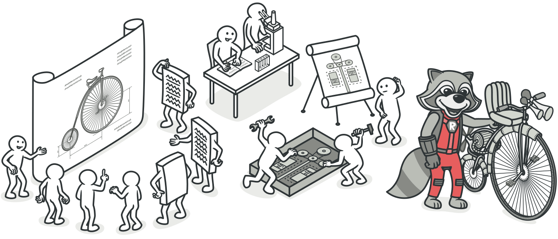
Design Patterns
Design patterns typical solutions to common problems in software design.
Each pattern is like a blueprint that you can customize to solve a particular design problem in your code.

Slide 32
Design Patterns
The Catalog of Design Patterns
Creational patterns
Provide various object creation mechanisms, which increase flexibility and reuse of existing code.
Structural patterns
Explain how to assemble objects and classes into larger structures while keeping these structures flexible and efficient.
Behavioral patterns
Concerned with algorithms and the assignment of responsibilities between objects.

Slide 33
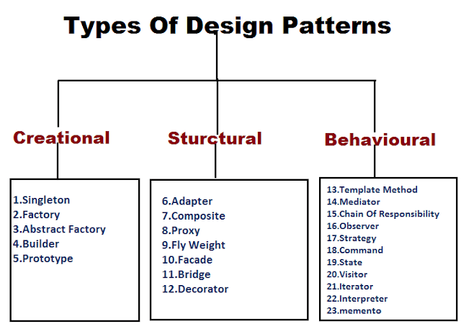
Design Patterns

Slide 34
Content
Introduction
Development Testing
JUnit Example
Design Pattern Introduction
Observer Example

Slide 35
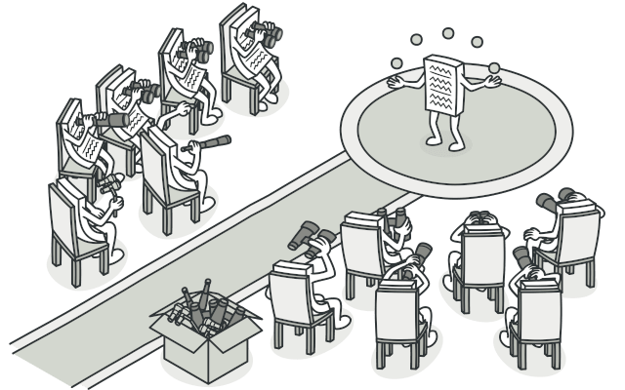
Observer Pattern
Define a subscription mechanism to notify multiple objects about any events that happen to the object they’re observing.
Also called: Event-Subscriber, Listener

Slide 36
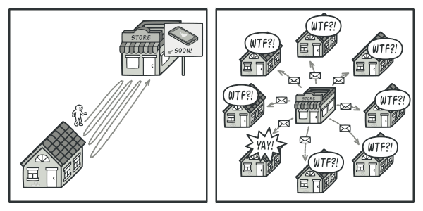

Observer Pattern
Problem: Imagine that you have two types of objects: a $Customer$ and a $Store$. The customer is very interested in a particular brand of product which should become available in the store very soon.
The customer could visit the store every day and check product availability.
The store could send tons of emails to all customers each time a new product becomes available.

Slide 37
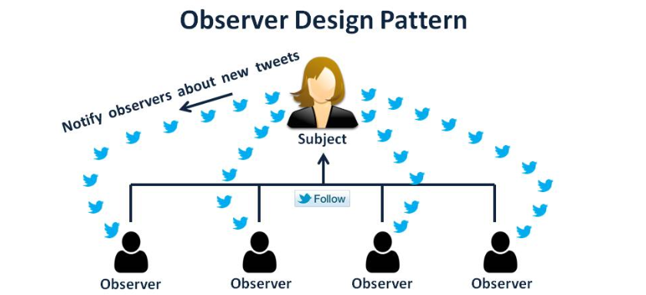
Observer Pattern
Solution: Define the problem as,
Subject (or Publisher): will notify other objects about the changes to its state. (Store)
Subscribers: all other objects that want to track changes to the publisher’s state (customers)

Slide 38
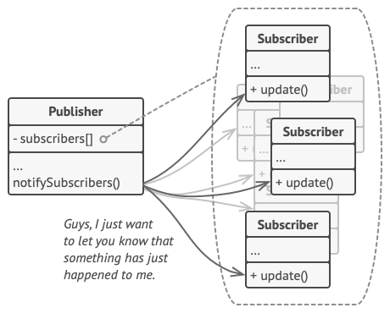
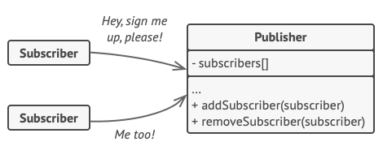
Observer Pattern
The Observer pattern suggests that you add a subscription mechanism to the publisher class so individual objects can subscribe to or unsubscribe from a stream of events coming from that publisher.

Slide 39
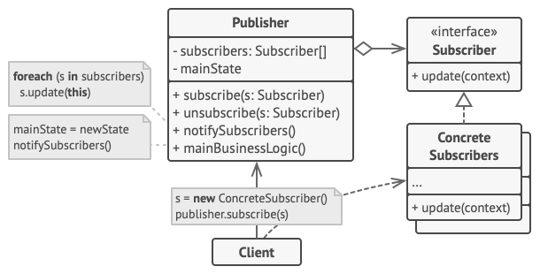
Observer Pattern
The Structure

